Slide 1
SIRC of ICAI
Empanelment Criteria for CAG
CA Niranjan Joshi
29.06.2024
SIRC VCM
Restriction on Disclosure and Use of Data
The data in this document contains trade secrets and confidential or proprietary information of my firm, the disclosure of which would provide a competitive advantage to others. As a result, this document shall not be disclosed, used or duplicated, in whole or in part, for any purpose. The data subject to this restriction are contained in the entire document.

Slide 2
Disclaimer
These are my personal views and can not be construed to be the views of the ICAI or my firm.
No representations or warranties are made by the RC/Branch/Study Circle of RC with regard to this presentation.
These views do not and shall not be considered as a professional advice.
This presentation should not be reproduced in part or in whole, in any manner or form, without our written permission.
CA Niranjan Joshi

Slide 3
CAG Policy of Empanelment
care.cag.gov.in/policy/policy24-25.htm
Empanelment Criteria
Quantitative Points (4)
Qualitative Points (4)
Professional Track Record Points (5)
CA Niranjan Joshi

Slide 4
Quantitative Parameters
3 Points for each FCA Partner (max 5 partner)
Points for Full Time CA Partners / Proprietor (Maximum upto 20)
Association of Partners with Firm/LLP
2 Points for each ACA Partner (max 5 partner)
1 Point each between 5-10 years association
2 points each for above 10 years association
Max 15 partners will get 50% of Points whether FCA or ACA
Full Time Paid CA Employee
Experience of Firm 0.5 Points for every calander year – Max 10 Points
1 Point each for 5 Full Time CA Employees
0.5 Point each for remaining 15 Full Time CA Employees
CA Niranjan Joshi

Slide 5
Qualitative Parameters
Firm Peer Reviewed by ICAI Maximum 25 Points
[5+4+4+3+3+2+2+1+1]
Statutory Audit Corporate Maximum 20 Points
Points for Qualification of Full Time CA Partners (upto Max 20)
CISA/ISA/CPA/CIA/CFE
1.25 Points each
Audit Experience Maximum 40 Points
Statutory Audit Branch Maximum 5 Points
ICAI Certificate Course
1 Points each
Internal Audit Maximum 5 Points
Audit of Government Schemes Maximum 5 Points
Full time CA Employee CISA/ISA/CPA/CIA/CFE
1 Points each
Based on Maximum Points scored by Firm and then discounted for others under each catagory
CA Niranjan Joshi

Slide 6
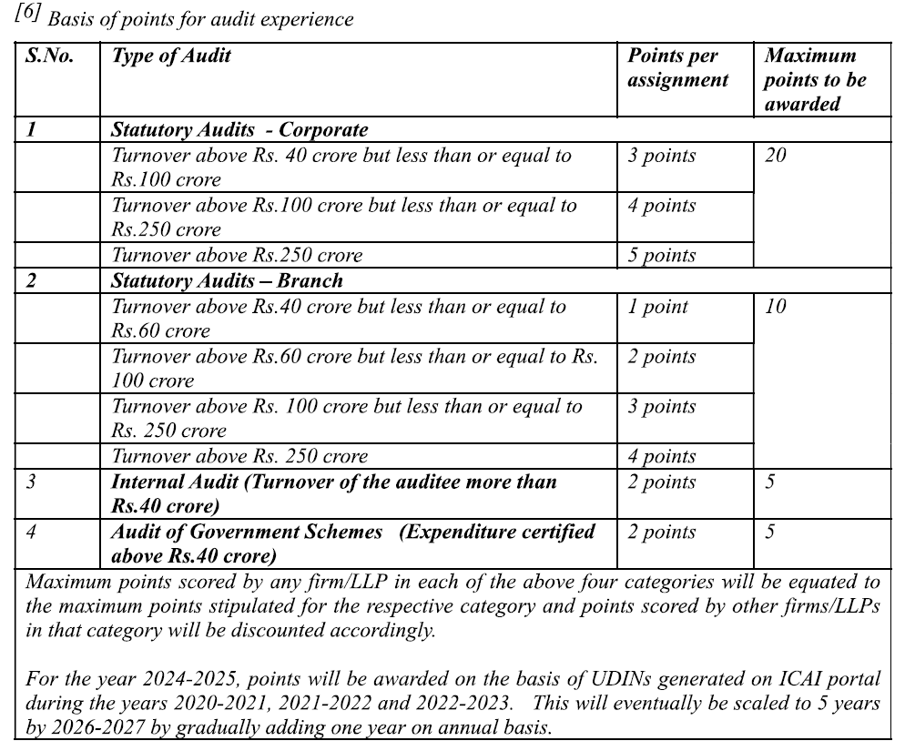
Qualitative Parameters
CA Niranjan Joshi

Slide 7
Qualitative Parameters
Deductions on account of
Unsatisfactory Performance Advisory Issued – 10% of total Points
Held Guilty of Professional Misconduct by ICAI – Per partner 10% of total Points
Non Technical Refusal
10% of total Points
Reprimand by QRB (Advisory Issued) 10% of Total Points
Reprimand by NFRA (Advisory Issued) 10% of Total Points
CA Niranjan Joshi

Slide 8
Allotment of Audits
Selection of Firm/LLP for Audit Fee Up to 5.00 L
Selection is made by correlating the point score of each firm/LLP with audit fee of unit
Selection of Firm/LLP for Audit Fee more than 5.00 L (Major Audit)
Firm should have at least 6 full time Cas (5 Partners + 1 Full Time Paid CA)
1 Partner > 10 Y
3 Partners 5 < 10 Y
2 Partners > 1 Y
1 CISA/DISA
5 Years Audit Assignedby CAG
Correlation to Points scored
CA Niranjan Joshi

Slide 9
Full Time Partner
Full time partner does not include a person
CA is partner / proprietor in other firm
Employed somewhere/ practicing in own name
Pratners drawing compensation below FCA 6.00 L & ACA 3.60 L
Del, Mum, Che, Kol, Blr, Hyd
Pratners drawing compensation
Below FCA 3.60 L & ACA 2.40 L
Other City
Partners % is less than
> 14 Partners = 1%
10 to 14 Partners = 3%
5 to 9 Partners = 5%
< 5 Partners = 8%
Partners / Proprietors other Income (Other than permitted by ICAI) is more than Professional Income
CA Niranjan Joshi

Slide 10
Other Considerations
Full time CA Employee does not include CA who is Partner in other firm or sole Proprietor
Partner / Paid CA Will get points on exclusive association
In case of Merger, Points will be allotted to partners after 1 Calander year and benefit of earlier association will be available after completion of 5 Calander years
Points for Turnover of Firm
Del, Mum, Che, Kol, Blr, Hyd / Other Cities
Up to 1 Cr / 0.60 Cr = 0 Points
> 1 Cr --- 2 Cr / > 0.60 Cr ---1.20 Cr = 1 Points
> 2 Cr --- 3 Cr / > 1.20 Cr ---1.80 Cr = 2 Points
> 3 Cr --- 4 Cr / > 1.80 Cr ---2.40 Cr = 3 Points
> 4 Cr --- 5 Cr / > 2.40 Cr ---3.00 Cr = 4 Points
> 5 Cr --- 6 Cr / > 3.00 Cr ---3.60 Cr = 5 Points
CA Niranjan Joshi

Slide 11
CA Niranjan Joshi,
B.Com., FCA, DISA (ICAI)
Email: nvjca1@gmail.com
Cell: 8369577210

